Slide 1

SENTIMENT ANALYSIS USING MACHINE LEARNING Project Synopsis Presentation Date: 01/05/2023
MAJOR-PROJECT (ICI651)
Degree : BACHELOR OF COMPUTER APPLICATION(CTIS)I-NURTURE
Project Guide:
Mr. VIJAY PRAKASH SENIOR IT FACULTY
Student
TANYA PAL (TCA2056023)
MANISHA SINGH (TCA2056014)
FACULTY OF ENGINEERING & COMPUTING SCIENCES
TEERTHANKER MAHAVEER UNIVERSITY, MORADABAD

Slide 2

Team Details
Student Name | Role
TANYA PAL | Developer, Testing etc.
MANISHA SINGH | Testing, Documentation
Guidelines: Mention Team Names & their role in project
2
T011A/ Template Version 5.0

Slide 3
Table Of Content
Project brief
Technologies \Tools to be used
Data Flow Diagram
Advantage of the Project
Screenshot of the Code
References
Guidelines: Mention brief about the project and it’s functions/ modules
3
T011A/ Template Version 5.0

Slide 4
Project Brief
Sentiment Analysis is a powerful technique that involves identifying and extracting subjective information from text data. It has gained tremendous popularity in recent years due to the explosion of social media platforms, which generate a vast amount of unstructured text data every day. In this project, we will use Machine Learning algorithms to perform Sentiment Analysis on airline reviews.
The problem we are addressing in this project is to perform Sentiment Analysis on airline reviews using Machine Learning algorithms. With the growth of social media platforms, airlines are receiving feedback from customers in the form of tweets, reviews, and other social media posts. This feedback can be valuable to airlines to improve their services and understand their customers' needs. However, analyzing this feedback manually can be time-consuming and inefficient. Sentiment Analysis can automate this process and provide airlines with quick insights into their customers' sentiments.
Our goal in this project is to build a model that can accurately classify airline reviews into three categories: positive, negative, and neutral. We will use the Airline Twitter Sentiment dataset, which contains tweets about various airlines. The dataset has three classes: positive, negative, and neutral. The dataset is unbalanced, with a majority of tweets being negative.
4
T011A/ Template Version 5.0

Slide 5
Technologies/Tools to be used
Technologies :- PYTHON
MACHINE LEARNING
NUMPY
PANDAS
Tools to be used:- JUPYTER NOTEBOOK
GOOGLE COLAB
5
T011A/ Template Version 5.0

Slide 6
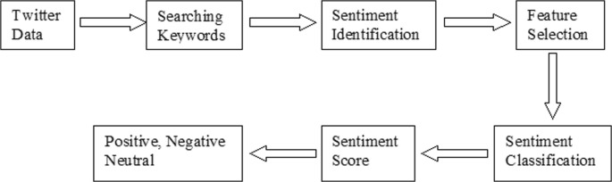
Data Flow Diagram
6
T011A/ Template Version 5.0

Slide 7
Advantage of the Project
Improved Customer Satisfaction: By analyzing customer reviews, airlines can identify areas where they need to improve their services, and take corrective action to improve customer satisfaction.
Competitive Advantage: By analyzing customer sentiment, airlines can gain insights into their competitors' strengths and weaknesses, and use this information to gain a competitive advantage.
Cost-effective: Sentiment analysis with machine learning can help airlines automate the process of analyzing customer reviews, reducing the need for manual analysis and making the process more cost-effective.
Real-time Insights: Sentiment analysis with machine learning can provide real-time insights into customer sentiment, allowing airlines to respond quickly to customer feedback.
Data-driven Decision Making: By analyzing customer reviews using sentiment analysis, airlines can make data-driven decisions based on customer feedback, rather than relying on intuition or guesswork.
Guidelines: Add more slides, if required to show all DFDs
7
T011A/ Template Version 5.0

Slide 8
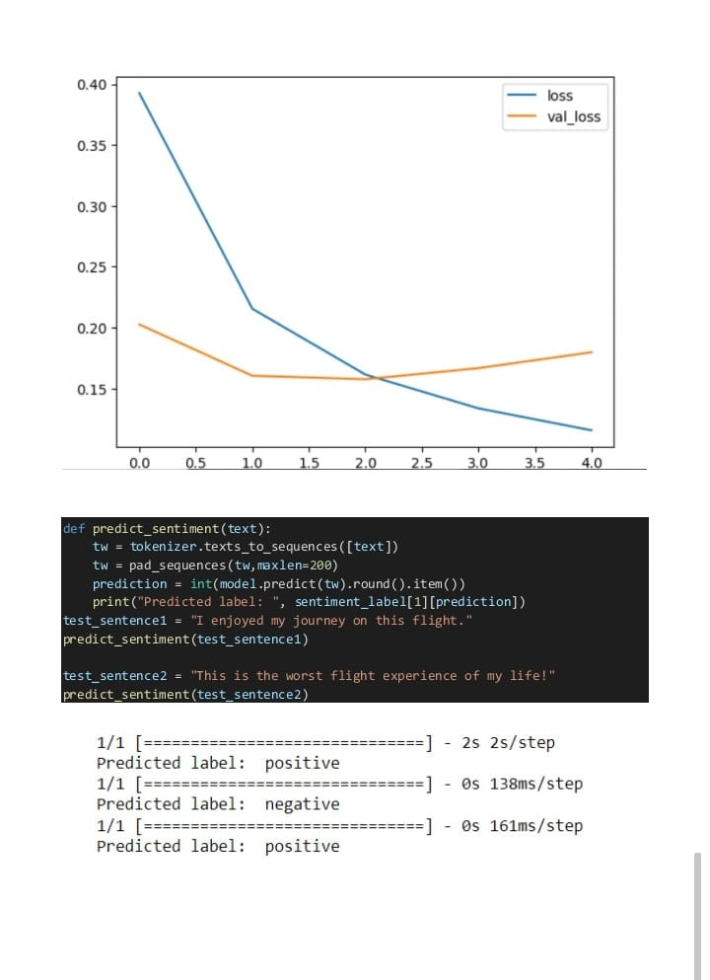
Screenshot of the Project
Guidelines: This slide is optional
8
T011A/ Template Version 5.0

Slide 9
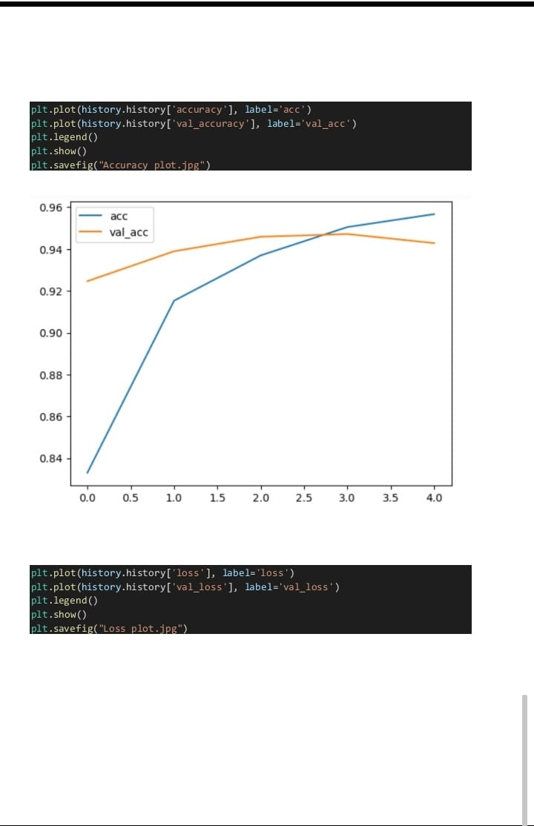
Screenshot of the Project
Guidelines: This slide is optional. May add more slide, if the details are available
9
T011A/ Template Version 5.0

Slide 10
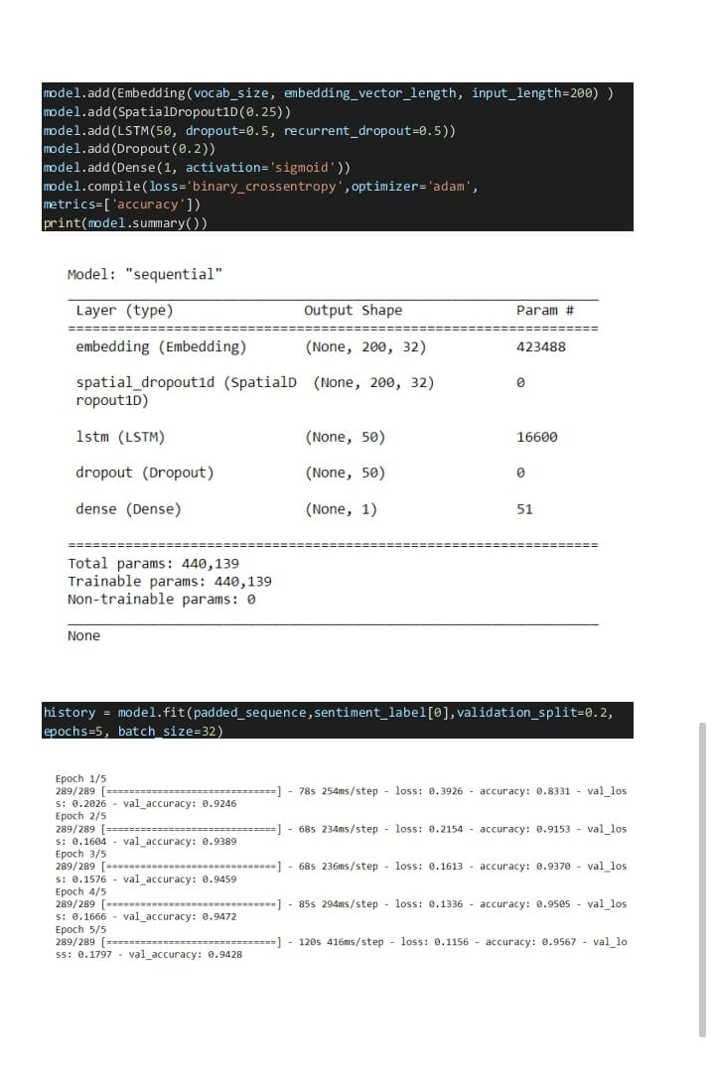
\
Screenshot of the Project
Guidelines: Mention advantage from this project, the audience/ users who will get benefitted
10
T011A/ Template Version 5.0

Slide 11
References, if any
Pang, B., & Lee, L. (2008). Opinion mining and sentiment analysis. Foundations and Trends® in Information Retrieval, 2(1-2), 1-135.
Ravi, K., & Ravi, V. (2015). A survey on opinion mining and sentiment analysis: tasks, approaches and applications. Knowledge-based systems, 89, 14-46.
Hu, M., & Liu, B. (2004, July). Mining and summarizing customer reviews. In Proceedings of the tenth ACM SIGKDD international conference on Knowledge discovery and data mining (pp. 168-177).
Yang, Z., Yang, D., Dyer, C., He, X., Smola, A., & Hovy, E. (2016). Hierarchical attention networks for document classification. In Proceedings of the 2016 Conference of the North American Chapter of the Association for Computational Linguistics: Human Language Technologies (pp. 1480-1489).
11
T011A/ Template Version 5.0

Slide 12
THANKS

